Slide 1
Apache Hive

Slide 2
What is Hive?
Hive is a data warehousing and SQL-like query language built on top of the Hadoop ecosystem. It provides a high-level abstraction for querying and managing large datasets stored in Hadoop's distributed file system (HDFS). Hive's primary objective is to enable analysts, data scientists, and business users to interact with Big Data without requiring expertise in complex programming languages or distributed systems.

Slide 3
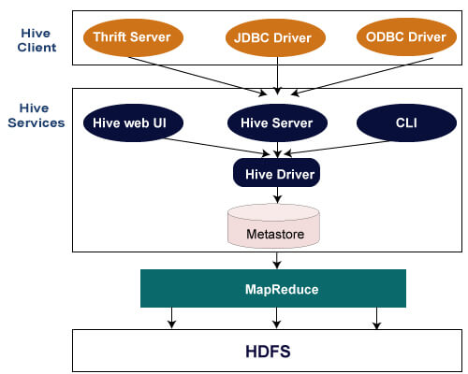
Hive Architecture

Slide 4
Hive Client
Hive allows writing applications in various languages, including Java, Python, and C++. It supports different types of clients such as:-
Thrift Server - It is a cross-language service provider platform that serves the request from all those programming languages that supports Thrift.
JDBC Driver - It is used to establish a connection between hive and Java applications. The JDBC Driver is present in the class org.apache.hadoop.hive.jdbc.HiveDriver.
ODBC Driver - It allows the applications that support the ODBC protocol to connect to Hive.

Slide 5
Hive Services
The following are the services provided by Hive:-
Hive CLI - The Hive CLI (Command Line Interface) is a shell where we can execute Hive queries and commands.
Hive Web User Interface - The Hive Web UI is just an alternative of Hive CLI. It provides a web-based GUI for executing Hive queries and commands.
Hive MetaStore - It is a central repository that stores all the structure information of various tables and partitions in the warehouse. It also includes metadata of column and its type information, the serializers and deserializers which is used to read and write data and the corresponding HDFS files where the data is stored.
Hive Server - It is referred to as Apache Thrift Server. It accepts the request from different clients and provides it to Hive Driver.

Slide 6
Hive Services
Hive Driver - It receives queries from different sources like web UI, CLI, Thrift, and JDBC/ODBC driver. It transfers the queries to the compiler.
Hive Compiler - The purpose of the compiler is to parse the query and perform semantic analysis on the different query blocks and expressions. It converts HiveQL statements into MapReduce jobs.
Hive Execution Engine - Optimizer generates the logical plan in the form of DAG of map-reduce tasks and HDFS tasks. In the end, the execution engine executes the incoming tasks in the order of their dependencies.

Slide 7
Comparison of Hive with other databases
1. Schema Flexibility
Traditional Databases: Traditional databases, often relational, require a well-defined schema upfront. Schema changes can be complex and may disrupt ongoing operations.
Hive: Hive provides schema-on-read, allowing users to define the structure of data during query execution. This flexibility is advantageous when dealing with unstructured or semi-structured data.

Slide 8
Comparison of Hive with other databases
2. Query Language
Traditional Databases: Relational databases use SQL as the standard query language, which is familiar to most data professionals.
Hive: Hive uses HQL, which closely resembles SQL. However, complex queries might perform slower due to the underlying MapReduce processing.

Slide 9
Comparison of Hive with other databases
3. Performance
Traditional Databases: Traditional databases are optimized for transactional operations and perform well for small to medium-sized datasets.
Hive: While Hive is scalable and suitable for large datasets, it may not match the real-time performance of traditional databases for ad-hoc queries.

Slide 10
Comparison of Hive with other databases
4. Data Processing Paradigm
Traditional Databases: Traditional databases are optimized for OLAP (Online Analytical Processing) or OLTP (Online Transaction Processing), depending on the use case.
Hive: Hive is well-suited for batch processing and data warehousing scenarios. Its performance shines in complex data transformations and analytics tasks.

Slide 11
Comparison of Hive with other databases
5. Use Cases
Traditional Databases: Traditional databases excel in scenarios where data is well-structured, and real-time processing is critical, such as online banking applications.
Hive: Hive is ideal for scenarios involving large-scale data processing, log analysis, social media analytics, and other Big Data use cases.

Slide 12
HiveQL
Hive Query Language (HiveQL) is a query language used with Apache Hive, a data warehousing and SQL-like query system built on top of Hadoop. HiveQL provides a familiar SQL-like interface for querying and managing large datasets stored in Hadoop Distributed File System (HDFS) or other compatible storage systems.

Slide 13
Hive QL
1. SQL-Like Syntax:
Familiarity: HiveQL syntax is similar to traditional SQL, making it accessible to users who are already familiar with relational databases and SQL queries.
High-Level Abstraction: HiveQL provides a high-level abstraction over the complexities of distributed data processing in Hadoop, allowing users to express queries without dealing directly with MapReduce or other underlying technologies.

Slide 14
Hive QL
2. Data Definition Language (DDL):
HiveQL supports DDL statements for defining and managing database objects such as tables, views, and partitions.
Example:
CREATE TABLE my_table ( id INT, name STRING, age INT );

Slide 15
Hive QL
3. Data Manipulation Language (DML):
DML statements in HiveQL are used for querying, inserting, updating, and deleting data in tables.
Example:
SELECT * FROM my_table WHERE age > 25;

Slide 16
Hive QL
4. Data Loading and Insertion:
HiveQL provides commands for loading data into tables, either from existing files or external sources.
Example:
LOAD DATA INPATH ‘/path/to/data’ INTO TABLE my_table;

Slide 17
Hive QL
5. Complex Data Types:
HiveQL supports complex data types such as arrays, maps, and structs, allowing users to work with semi-structured or nested data.
Example:
CREATE TABLE complex_table ( id INT, names ARRAY<STRING>, details MAP<STRING, INT> );

Slide 18
Hive QL
6. User-Defined Functions (UDFs):
Users can define custom functions, known as User-Defined Functions (UDFs), in HiveQL to perform operations not natively supported.
Example:
CREATE FUNCTION my_udf AS ‘com.example.MyUDF’ USING JAR ‘hdfs:///path/to/my_udf.jar’;

Slide 19
Apache Hive vs Apache Pig
S.No. | Pig | Hive
1. | Pig operates on the client side of a cluster. | Hive operates on the server side of a cluster.
2. | Pig uses pig-latin language. | Hive uses HiveQL language.
3. | Pig is a Procedural Data Flow Language. | Hive is a Declarative SQLish Language.
4. | It was developed by Yahoo. | It was developed by Facebook.
5. | It is used by Researchers and Programmers. | It is mainly used by Data Analysts.
6. | It is used to handle structured and semi-structured data. | It is mainly used to handle structured data.
7. | It is used for programming. | It is used for creating reports.
8. | Pig scripts end with .pig extension. | In HIve, all extensions are supported.
9. | It does not support partitioning. | It supports partitioning.
10. | It loads data quickly. | It loads data slowly.
11. | It does not support JDBC. | It supports JDBC.
12. | It does not support ODBC. | It supports ODBC.
13. | Pig does not have a dedicated metadata database. | Hive makes use of the exact variation of dedicated SQL-DDL language by defining tables beforehand.
14. | It supports Avro file format. | It does not support Avro file format.
15. | Pig is suitable for complex and nested data structures. | Hive is suitable for batch-processing OLAP systems.
16. | Pig does not support schema to store data. | Hive supports schema for data insertion in tables.
17. | It is very easy to write UDFs to calculate matrices. | It does support UDFs but is much hard to debug.

Slide 20
User Defined Functions in Hive
When the built-in functions of Hive cannot meet requirements, you can compile user-defined functions (UDFs) and use them in queries.
According to implementation methods, UDFs are classified as follows:
Common UDFs: used to perform operations on a single data row and export a single data row.
User-defined aggregating functions (UDAFs): used to input multiple data rows and export a single data row.
User-defined table-generating functions (UDTFs): used to perform operations on a single data row and export multiple data rows.

Slide 21
User Defined Functions in Hive
According to use methods, UDFs are classified as follows:
Temporary functions: used only in the current session and must be recreated after a session restarts.
Permanent functions: used in multiple sessions. You do not need to create them every time a session restarts.

Slide 22
User Defined Functions in Hive
The following uses AddDoublesUDF as an example to describe how to compile and use UDFs.
Function
AddDoublesUDF is used to add two or more floating point numbers. In this example, you can learn how to write and use UDFs.

Slide 23
User Defined Functions in Hive
A common UDF must be inherited from org.apache.hadoop.hive.ql.exec.UDF.
A common UDF must implement at least one evaluate(). The evaluate function supports overloading.
To develop a UDF, add the hive-exec-*.jar dependency package to the project. You can obtain the package from the Hive service installation directory, for example, ${BIGDATA_HOME}/components/FusionInsight_HD_*/Hive/disaster/plugin/lib/.

Slide 24
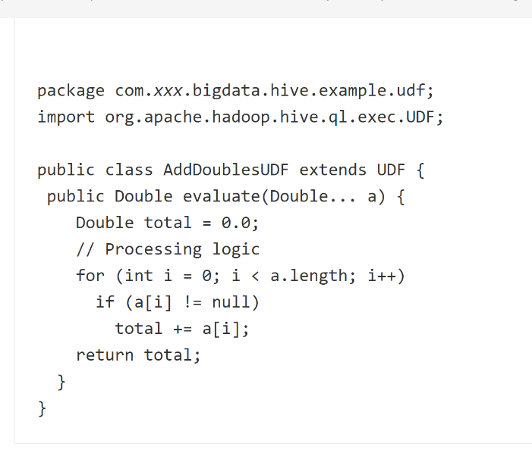
User Defined Functions in Hive
The following is a UDF code example:
xxx indicates the name of the organization that develops the program.

Slide 25
User Defined Functions in Hive
How to Use
Packing programs as AddDoublesUDF.jar on the client node, and upload the package to a specified directory in HDFS, for example, /user/hive_examples_jars.
Both the user who creates the function and the user who uses the function must have the read permission on the file.
The following are example statements:
hdfs dfs -put ./hive_examples_jars /user/hive_examples_jars
hdfs dfs -chmod 777 /user/hive_examples_jars

Slide 26
User Defined Functions in Hive
Check the cluster authentication mode.
In security mode, log in to the beeline client as a user with the Hive management permission and run the following commands:kinit Hive service user
beeline
set role admin;
In common mode, run the following command:beeline -n Hive service user

Slide 27
User Defined Functions in Hive
Define the function in HiveServer. Run the following SQL statement to create a permanent function:
CREATE FUNCTION addDoubles AS 'com.xxx.bigdata.hive.example.udf.AddDoublesUDF' using jar 'hdfs://hacluster/user/hive_examples_jars/AddDoublesUDF.jar';
addDoubles is the alias of the function, which is used in SELECT queries. xxx is typically the name of the organization that develops the program.

Slide 28
User Defined Functions in Hive
Run the following SQL statement to use the function on the HiveServer:
SELECT addDoubles(1,2,3);

